Slide 1
Discrete Structure
Unit 5.1 Counting

Slide 2
Basics of Counting
There are two basic counting principles that can be used to solve the counting problems
Sum Rule
Product Rule

Slide 3
Sum Rule
If a task can be done in n₁ ways and a second task in n₂ ways, and if these tasks cannot be done at the same time, then there are n₁ + n₂ ways to do one of these tasks
Example
In how many ways we can draw a heart or a diamond from an ordinary deck of playing cards?
Solution
There are total 13 cards of heart and 13 card of diamond. So, by sum rule total number of ways of picking heart or diamond is 13 + 13 = 26
Exercise
How many ways we can get a sum of 4 or of 8 when two distinguishable dice (say one die is red and the other is white) are rolled?

Slide 4
Product Rule
If a task can be done in n₁ ways and a second task in n₂ ways after the first task has been done, then there are n₁n₂ ways to do the work that consists both the task
Example
How many different three-letter initials with none of the letters can be repeated can people have?
Solution
Here the first letter can be chosen in 26 ways, since the first letter is assigned we can choose second letter in 25 ways and in the same manner we can choose third letter in 24 ways. So by product rule number of different three-letter initials are 26.25.24 = 15600
Exercise
How many strings are there of four lowercase letters that have the letter x in them?
How many different license plates are available if each plate contains sequence of three letters followed by three digits?

Slide 5
Pigeonhole Principle
If k + 1 or more objects are placed into k boxes, then there is at least one box containing two or more of the objects
Example
How many students must be in a class to guarantee that at least two students having the name start with same letter? (26 + 1 =27)
How many students must be in a class to guarantee that at least two students having the birthday at same day?

Slide 6
Pigeonhole Principle…
The Generalized Pigeonhole Principle
If N objects are placed into k boxes, then there is at least one box containing at least ⎡N/k⎤ objects
Example
Find the minimum number of people among 100 people who were born in the same month?
Among 100 people there are at least ⎡100/12⎤ = 9 who were born in the same month
What is the minimum number of students required in a discrete mathematics class to be sure that at least six will receive the same grade, if there are five possible grades A, B, C, D, and F

Slide 7
Permutations
A permutation of a set of distinct objects is an ordered arrangement of these objects
The number of r-permutations of a set with n elements is denoted by P(n, r)
P(n,r) = n! / (n-r)!
Example
How many ways are there to select a first-prizewinner, a second prize winner, and a third prize winner from 100 different people who have entered a contest?
P(100, 3) = 100.99.98 = 970,200
Suppose that there are eight runners in a race. The winner receives a gold medal, the second-place finisher receives a silver medal, and the third-place finisher receives a bronze medal. How many different ways are there to award these medals, if all possible outcomes of the race can occur and there are no ties?

Slide 8
Permutations…
Find the number of words, with or without meaning, that can be formed with the letters of the word “NEPAL”
Find the number of words, with or without meaning, that can be formed with the letters of the word “PARPAL”
Find the number of permutations of the letters of the word ‘REMAINS’ such that the vowels always occur in odd places?
(Ans = 576)

Slide 9
Combinations
An r-combination of elements of a set is an unordered selection of r elements from the set
Denoted by C(n,r)
C(n,r) = n! / r! (n-r)!
Example
How many ways to select five players from a 10-member tennis team to make a trip to a match at another school?
C(10, 5) = 10! / 5!(10 – 5)! = 10! / 5!5! = 252
A group of 30 people have been trained as astronauts to go on the first mission to Mars. How many ways are there to select a crew of six people to go on this mission (assuming that all crew members have the same job)?

Slide 10
Combinations…
In how many ways can a committee of 1 man and 3 women can be formed from a group of 3 men and 4 women?
Among a set of 5 black balls and 3 red balls, how many selections of 5 balls can be made such that at least 3 of them are black balls.
How many 4 digit numbers that are divisible by 10 can be formed from the numbers 3, 5, 7, 8, 9, 0 such that no number repeats?
Ans = 12
Ans = 46
Ans = 60

Slide 11
Binomial Coefficients
The number of r-combinations from a set with n elements is often denoted by
This number is also called a binomial coefficient because these numbers occur as coefficients in the expansion of powers of binomial expressions such as (a + b)^{n}.

Slide 12

The Binomial Theorem
Let x and y be variables, and let n be a nonnegative integer. Then
Example
What is the expansion of (x + y) ^{4?}
What is the coefficient of x¹²y¹³ in the expansion of (x + y) ²⁵?
What is the coefficient of x¹²y¹³ in the expansion of (2x - 3y) ²⁵?

Slide 13






The Binomial Theorem…
Corollary 1
Corollary 2
Corollary 3

Slide 14
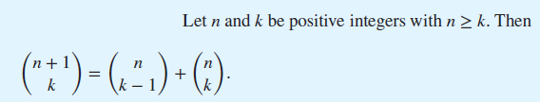

Pascal’s Identity and Triangle
Pascal’s Identity
Pascal’s Triangle
Pascal’s identity is the basis for a geometric arrangement of the binomial coefficients in a triangle
The nth row in the triangle consists of the binomial coefficients

Slide 15
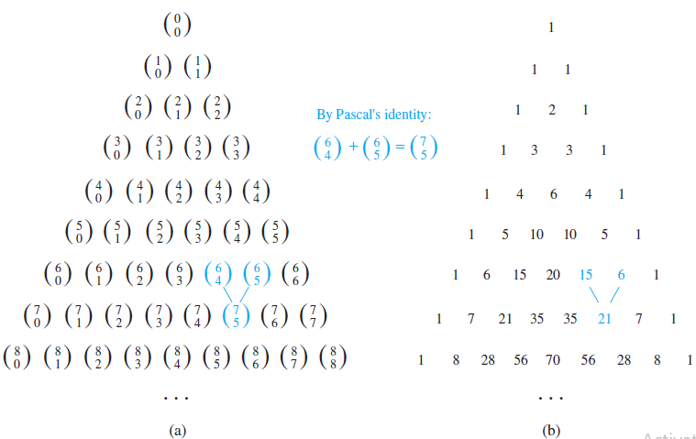
Pascal’s Identity and Triangle(Example)…

Slide 16
Generalized Permutation and Combination
Two cases
Permutation and Combination with repetition
Permutation and Combination with indistinguishable objects

Slide 17
Permutation with Repetition
Counting permutations when repetition of elements is allowed can easily be done using the product rule
Example
How many string of length 3 can be formed from the uppercase letters of the English alphabet?
Ans = 26 * 26 * 26

Slide 18
Combination with Repetition
There are C(n + r − 1, r) = C(n + r − 1, n − 1) r-combinations from a set with n elements when repetition of elements is allowed
Example
Suppose that a cookie shop has four different kinds of cookies. How many different ways can six cookies be chosen? Assume that only the type of cookie, and not the individual cookies or the order in which they are chosen, matters
Ans = C(4+6-1, 6) = C(9,6) = 84
Exercise
How many solutions does the equation x₁ + x₂ + x₃ = 11, where x₁, x₂ and x₃ are non negative integers?
Ans=78

Slide 19
Permutations with Indistinguishable Objects
The number of different permutations of n objects, where there are n₁ indistinguishable objects of type 1, n₂ indistinguishable objects of type 2,…, and n_{k} indistinguishable objects of type k, is n! / (n₁!*n₂!*…..*n_{k}!)
Example
How many different strings can be made by reordering the letters of the word SUCCESS
Ans = 7! / (3!*2!*1!*1!) = 420

Slide 20
Combination with Indistinguishable Objects
Example
How many ways are there to pack six copies of the same book into four identical boxes, where a box can contain as many as six books
No. of ways = {6}, {5,1}, {4,1,1}, {4,2}, {3,3}, {3,2,1}, {3,1,1,1}, {2,2,2}, {2,2,1,1}
9 ways

Slide 21
Generating Permutations
Lexicographic Ordering (Dictionary Ordering)
In this ordering, the permutation a₁a₂⋯a_{n} precedes the permutation of b₁b₂⋯b_{n}, if for some k, with 1 ≤ k ≤ n, a₁ = b₁, a₂ = b₂,…, a_{k-1} = b_{k-1}, and a_{k} < b_{k}
i.e. a permutation of the set of the n smallest positive integers precedes (in lexicographic order) a second permutation if the number in this permutation in the first position where the two permutations disagree is smaller than the number in that position in the second permutation
Example
The permutation 23415 of the set {1, 2, 3, 4, 5} precedes the permutation 23514, because these permutations agree in the first two positions, but the number in the third position in the first permutation, 4, is smaller than the number in the third position in the second permutation, 5.

Slide 22
Generating Permutations…
What is the next permutation in lexicographic order after 362541?
The last pair of integers a_{j} and a_{j+1} where a_{j} < a_{j+1} is a₃ = 2 and a₄ = 5. The least integer to the right of 2 that is greater than 2 in the permutation is a₅ = 4. Hence, 4 is placed in the third position. Then the integers 2, 5, and 1 are placed in order in the last three positions in increasing order, giving 125 as the last three positions of the permutation. Hence, the next permutation is 364125
Exercise
Find the next larger permutation in lexicographic order after each of these permutations
1432, 54123, 31528764
2134
54132
31542678

Slide 23
Generating Combinations
Combinations are subsets of a set
Combination or subset of n elements can be placed in one-to-one correspondence with the number of bit strings of length n
Example
Find the next largest bit string 110110111
Solution
Take the rightmost 0, change it to 1, and replace all the digits to the right of this with 0’s. So here the answer is 110111000
There are 5 faculty members in a department, and sometimes they show up a football games. In how many combinations can these faculty members show up for the game?
Solution
For each of these faculty members, there are two situations, they either show up or don’t show up. Thus, there are 2⁵ = 32 (11111)combinations
The bit strings 00000 corresponds to none of them showing up, while the bit strings 10010 corresponds to the 1st and 4th faculty member showing up.

Slide 24
End of Session 5.1

